Slide 1
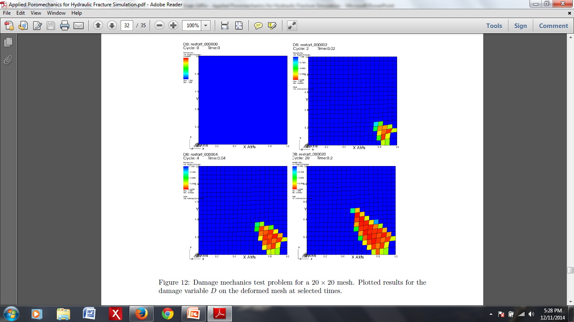
Applied Poromechanics for Hydraulic Fracture Simulation
Brian Giffin
under the advisement of Dr. Mark Rashid
and in collaboration with Dr. Randolph Settgast
December 12, 2014

Slide 2
Overview
Introduction
Poromechanics
Damage Mechanics
MATLAB Implementation
GEOS Implementation
Conclusions & Future Work

Slide 3
Introduction
Collaboration with LLNL
Interest in modeling hydraulic fracturing
GEOS: hydraulic fracture-specific code
Main Goal: Implement a new modeling approach within GEOS

Slide 4
Approach
Homogenized (``Smeared’’) Approach for Modeling Hydraulic Fracture
Treat cracked rock mass as a homogenized medium
Variable hydraulic conductivity (k)
Variable material properties (μ, λ)
Evolve constitutive behavior via a damage parameter (D) to simulate crack propagation

Slide 5
Poromechanics
Coupled solution of solid deformation and flow in a porous medium
Quasi-static deformation
Fully saturated, single phase, diffusive fluid flow
Consider a RVE to define the poroelastic solid
Φ: Pore volume in the current (deformed) configuration to the total RVE volume in the reference configuration
Φ₀: Initial pore volume in the reference (undeformed) configuration to the total RVE volume in the reference configuration
Φ ≈ Φ₀: For small deformations

Slide 6
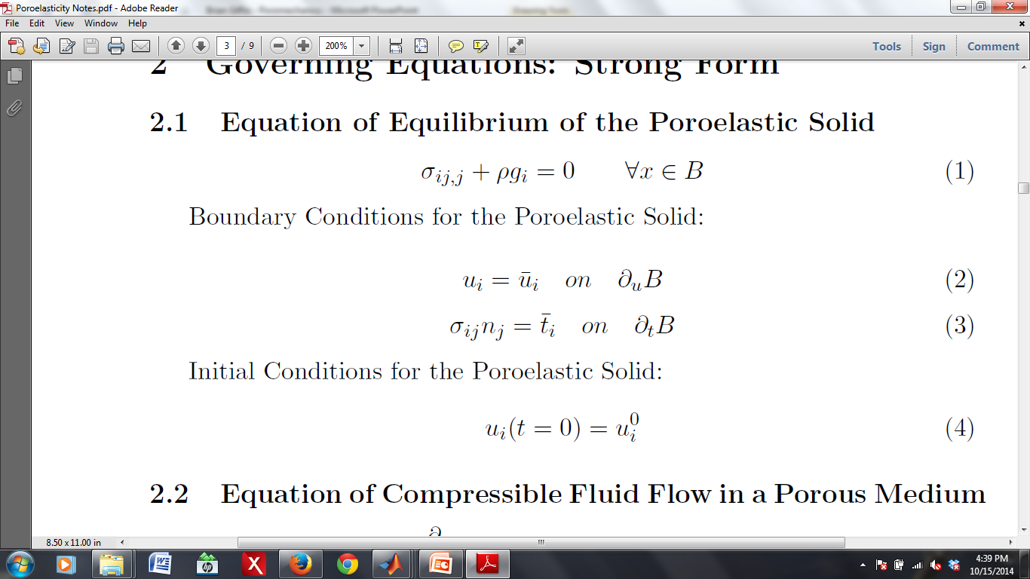
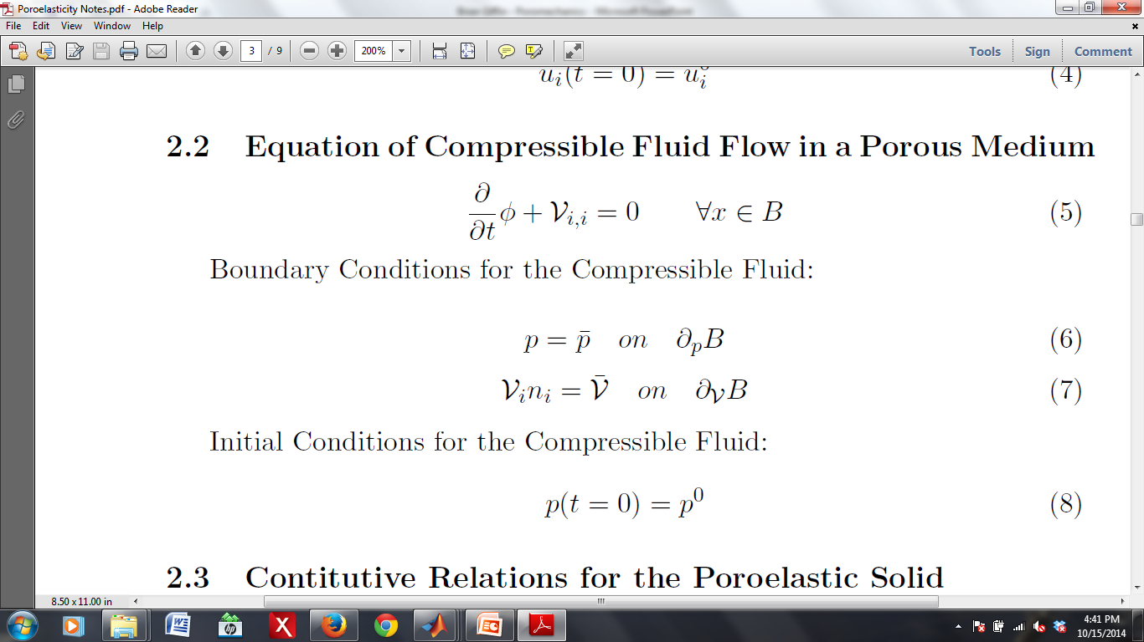
Governing Equations
Equilibrium of the Poroelastic Solid
Compressible Fluid Flow in a Porous Medium
σ_{ij}: Total stress tensor
ρ: Overall mass density per unit of initial (undeformed) volume
g_{i}: Gravitational body force (vector)
V_{i}: Volumetric fluid flux
Φ: Lagrangian porosity

Slide 7
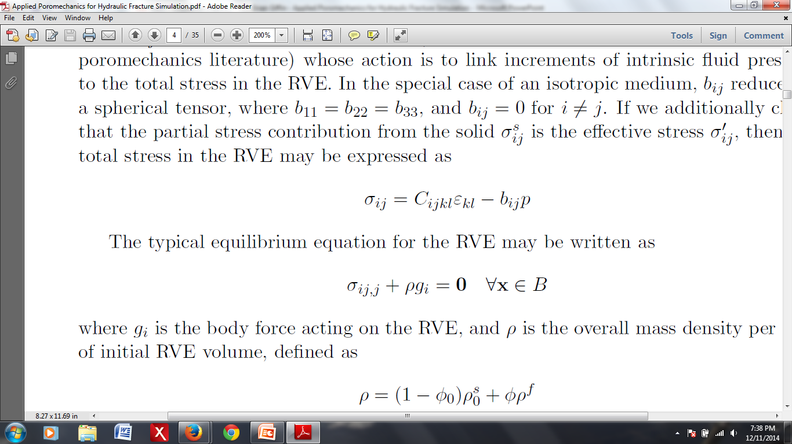
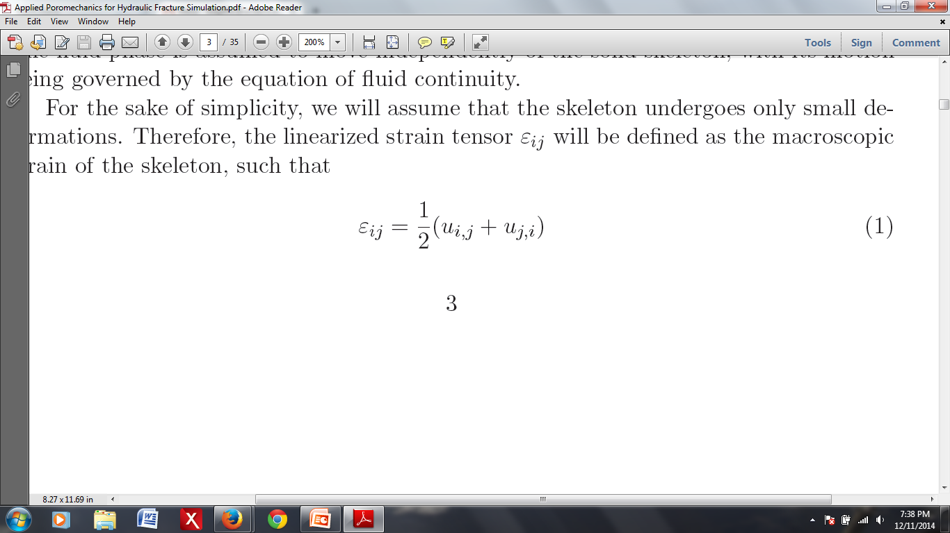
Constitutive Relations
For the Poroelastic Solid
C_{ijkl}: Tangent stiffness modulus of the “skeleton”
ε_{ij}: ``Skeleton” strain tensor
b_{ij}: Biot's modulus (symmetric rank 2 tensor; links total stress and fluid pressure increments)
p: Fluid (pore) pressure
u_{i}: Displacement of the ``skeleton”

Slide 8
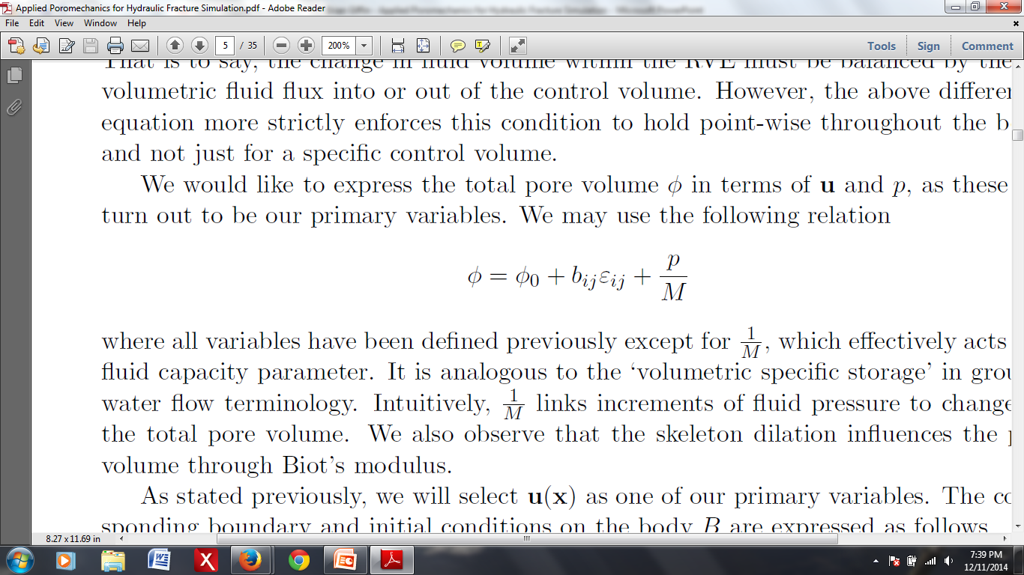
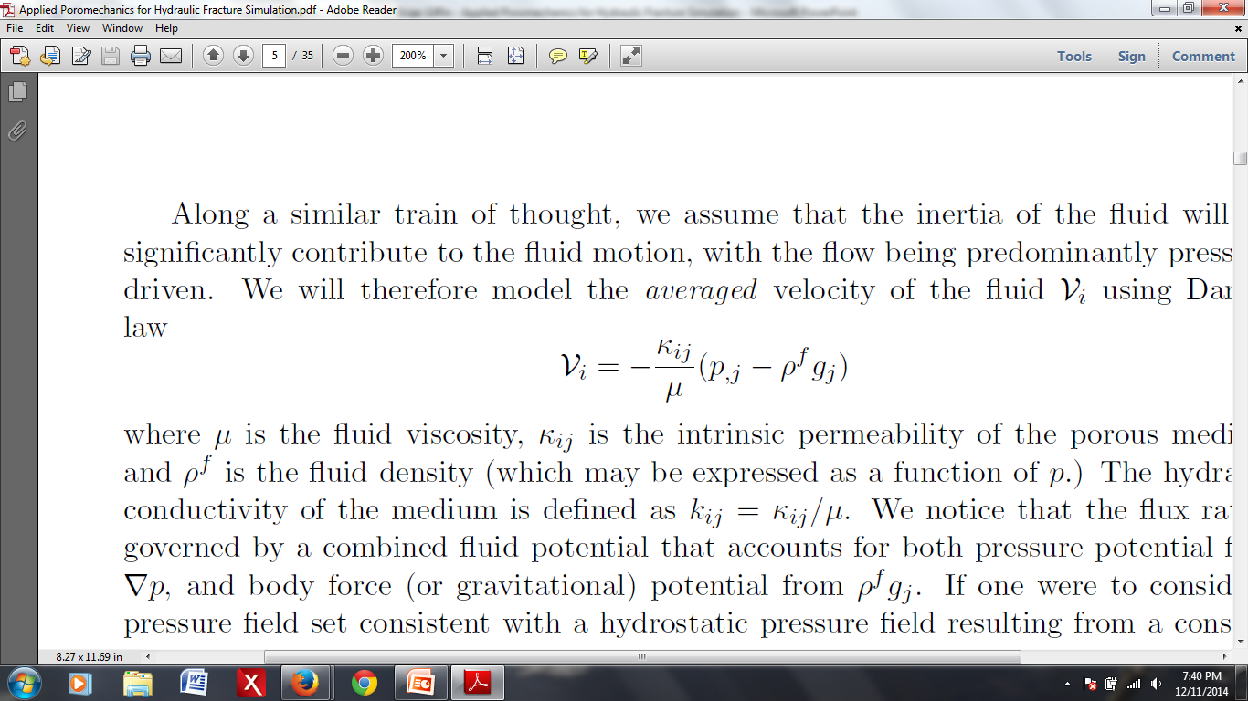
Constitutive Relations
For the Compressible Fluid
1/M: Fluid capacity parameter (scalar valued quantity that links pore pres-
sure and porosity variation)
κ_{ij}: Intrinsic permeability tensor
μ: Fluid viscosity
ρ^{f}: Intrinsic fluid mass density

Slide 9
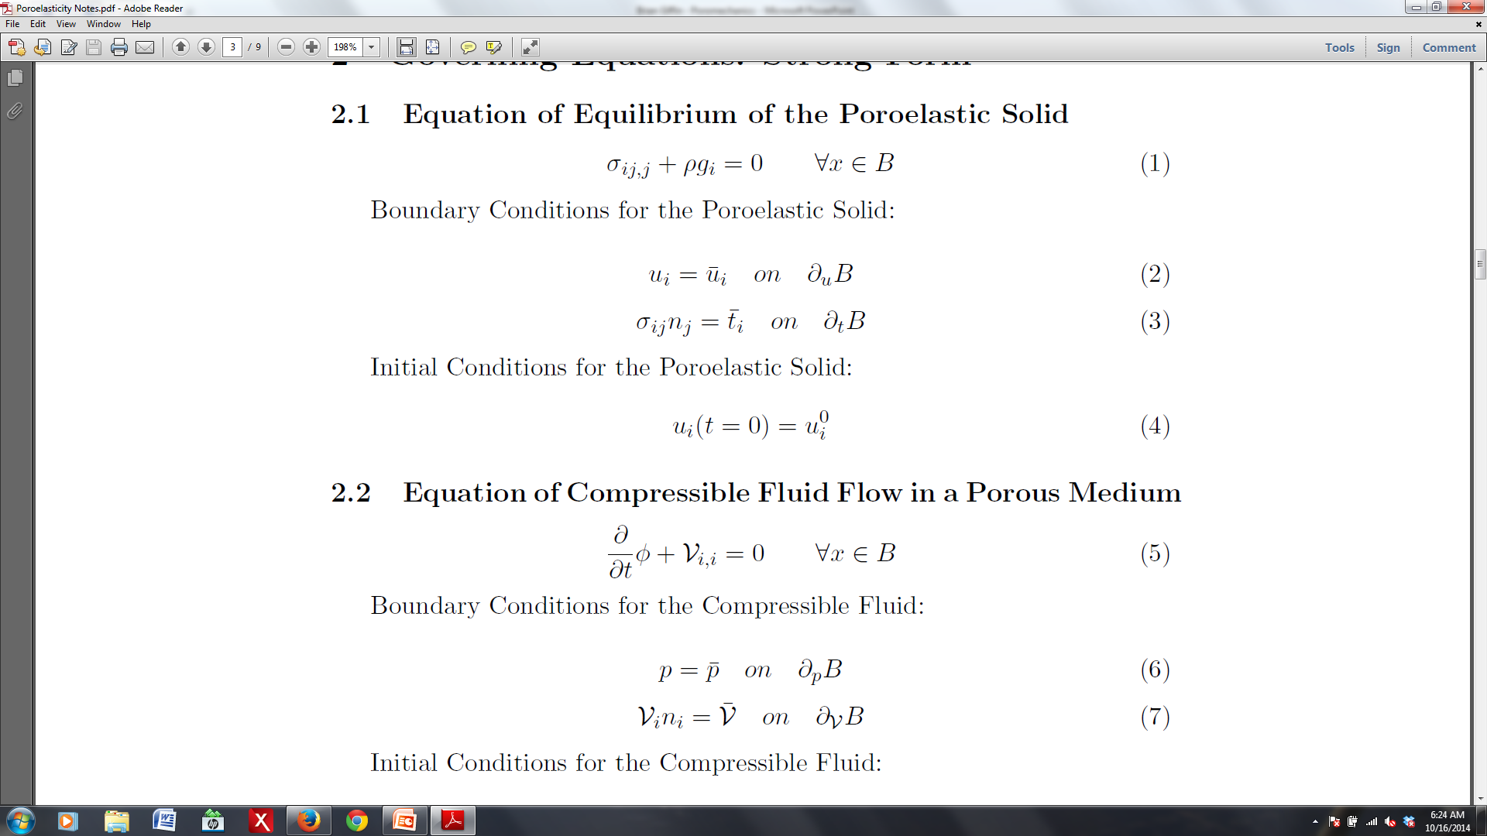
Boundary Conditions
For the Poroelastic Solid
For the Compressible Fluid

Slide 10
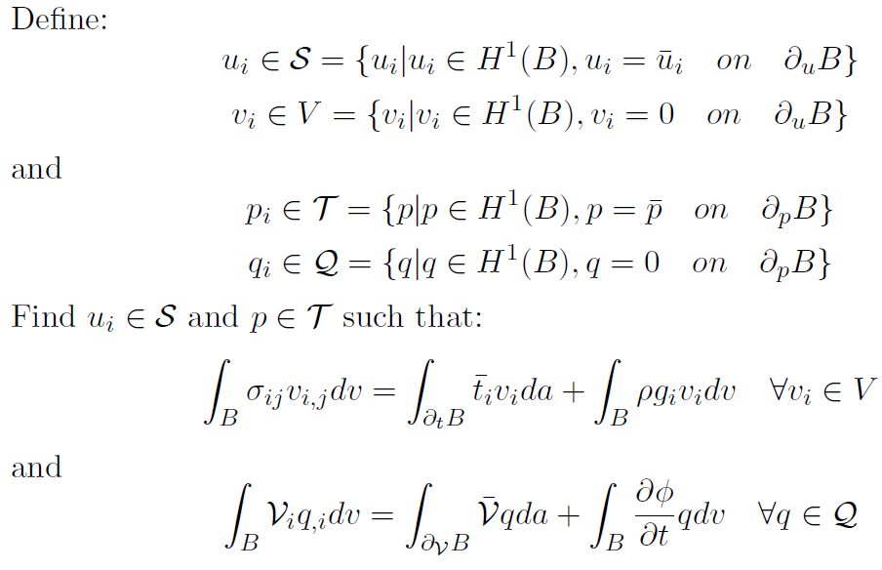
Statement of the Weak Form

Slide 11
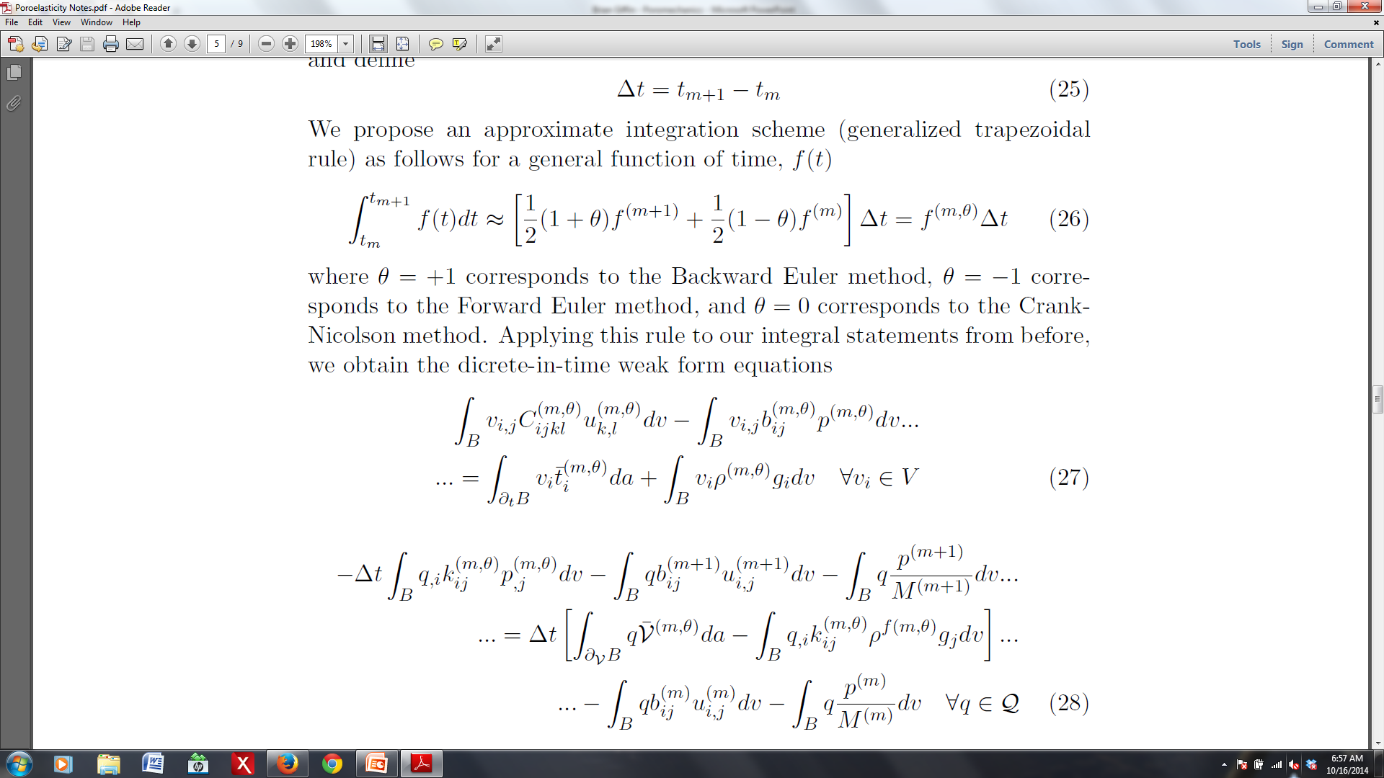
Discrete in Time Equations

Slide 12
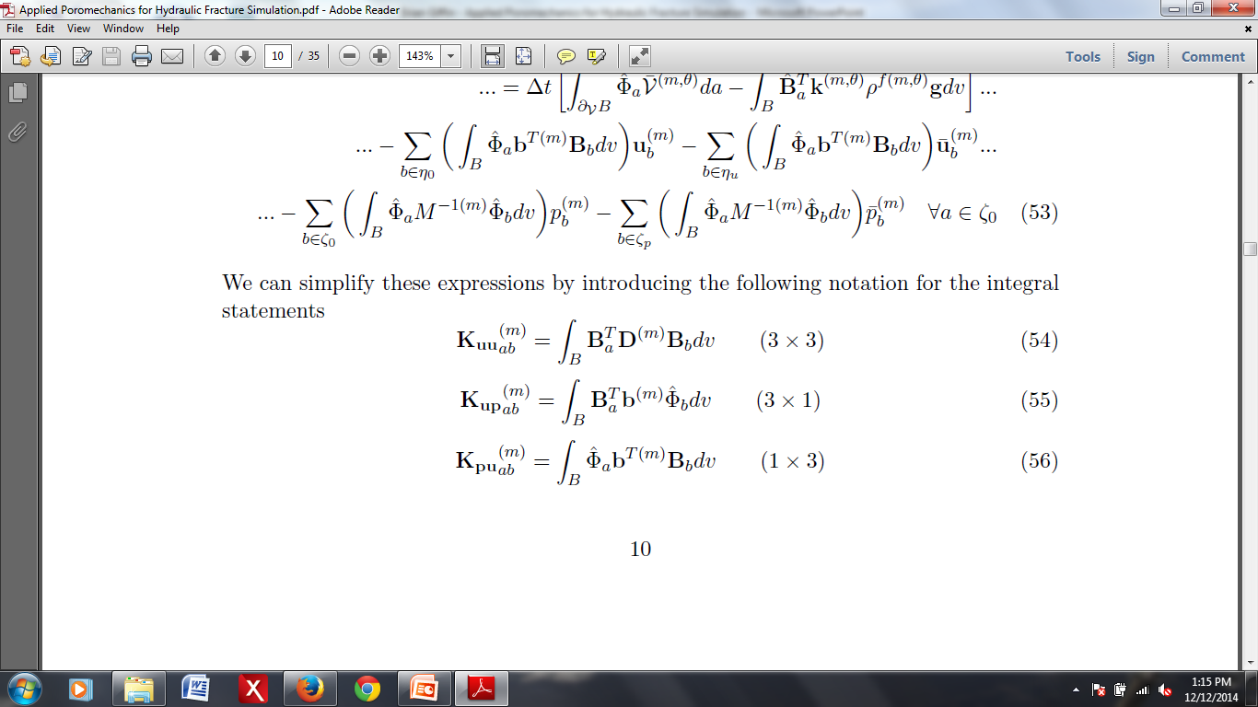
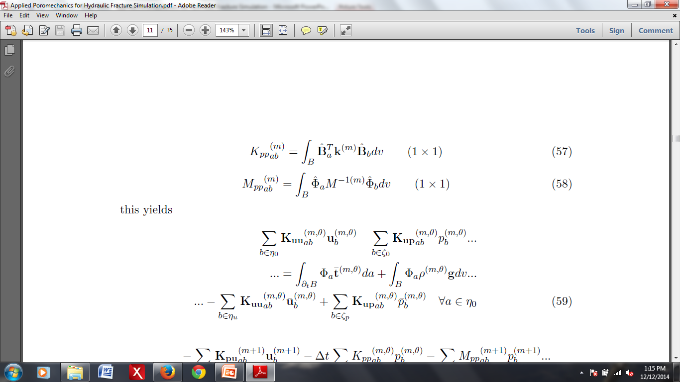
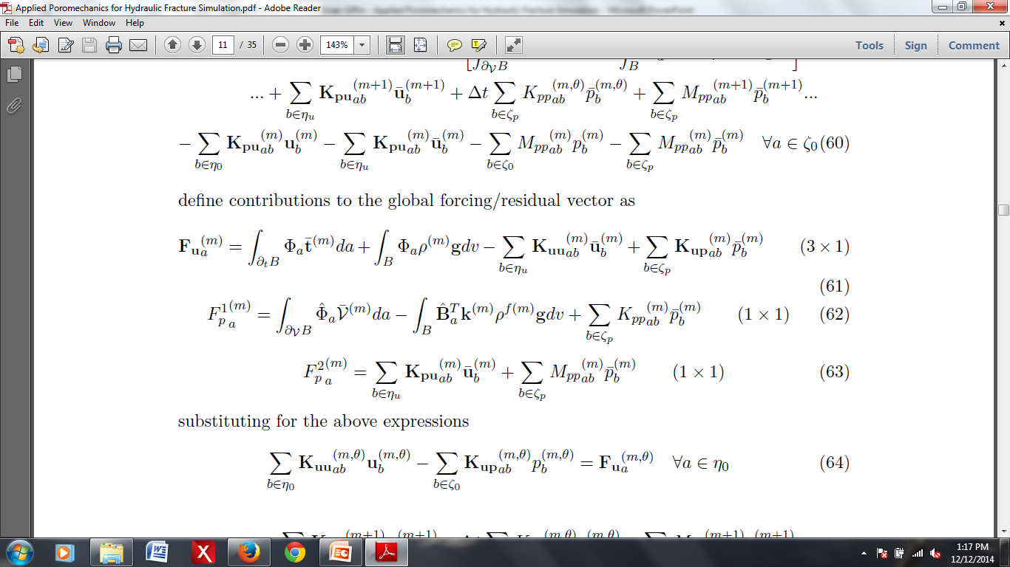
Galerkin Approximation

Slide 13
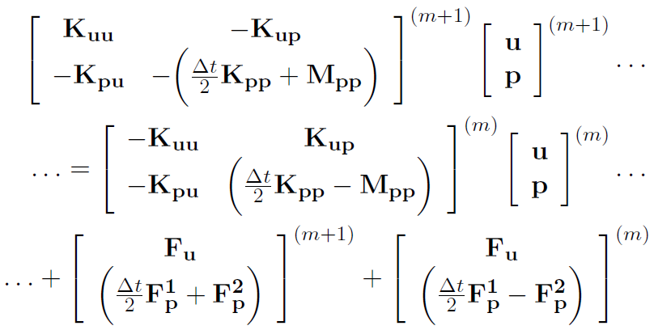
Matrix Form

Slide 14
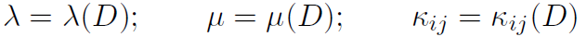
Damage Mechanics
Consider a damage parameter D ϵ (0,1]
Evolve material properties using an appropriate failure criterion to emulate fracture
Desired behavior:
σ_{t} << σ_{c} (lower tensile rupture stress)
Material failure should be pressure-dependent
Failure should depend upon the deviatoric stress

Slide 15
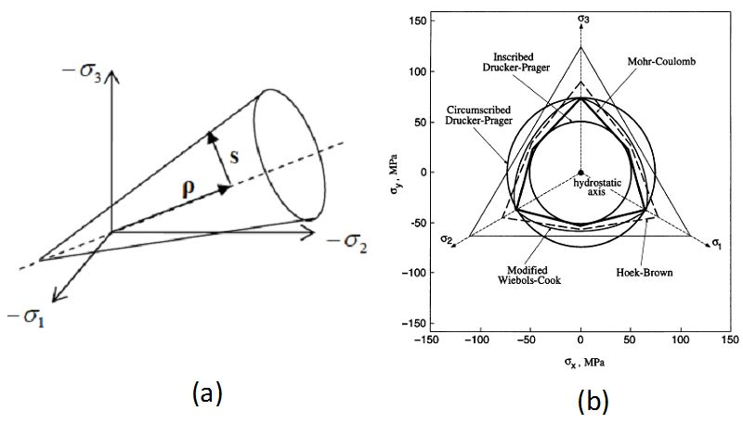
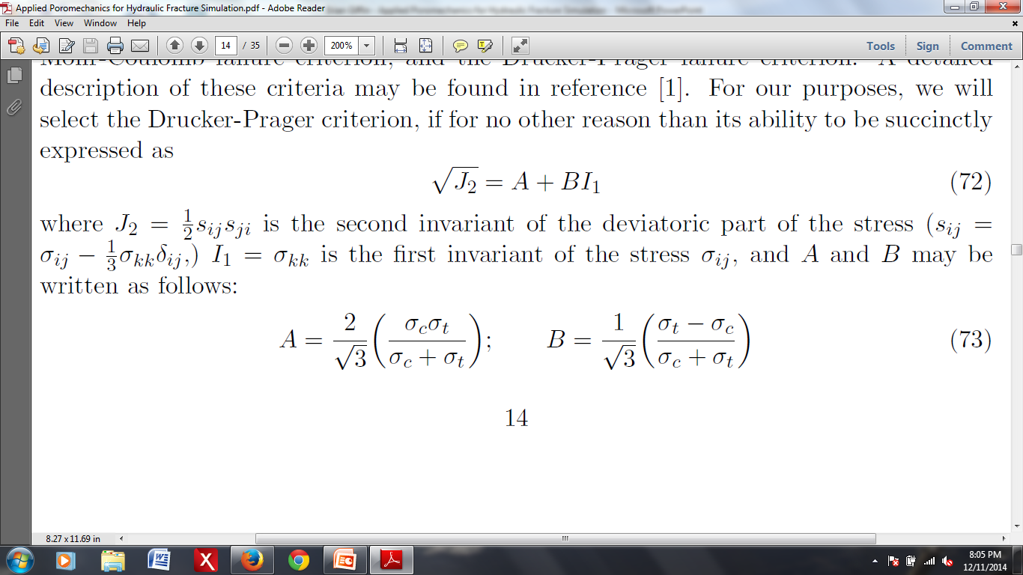
Failure Criterion
Drucker-Prager failure criterion:
J2: second invariant of the deviatoric part of the effective skeleton stress
I1: first invariant of the effective skeleton stress
A, B: constants that depend on σ_{t} and σ_{c}

Slide 16
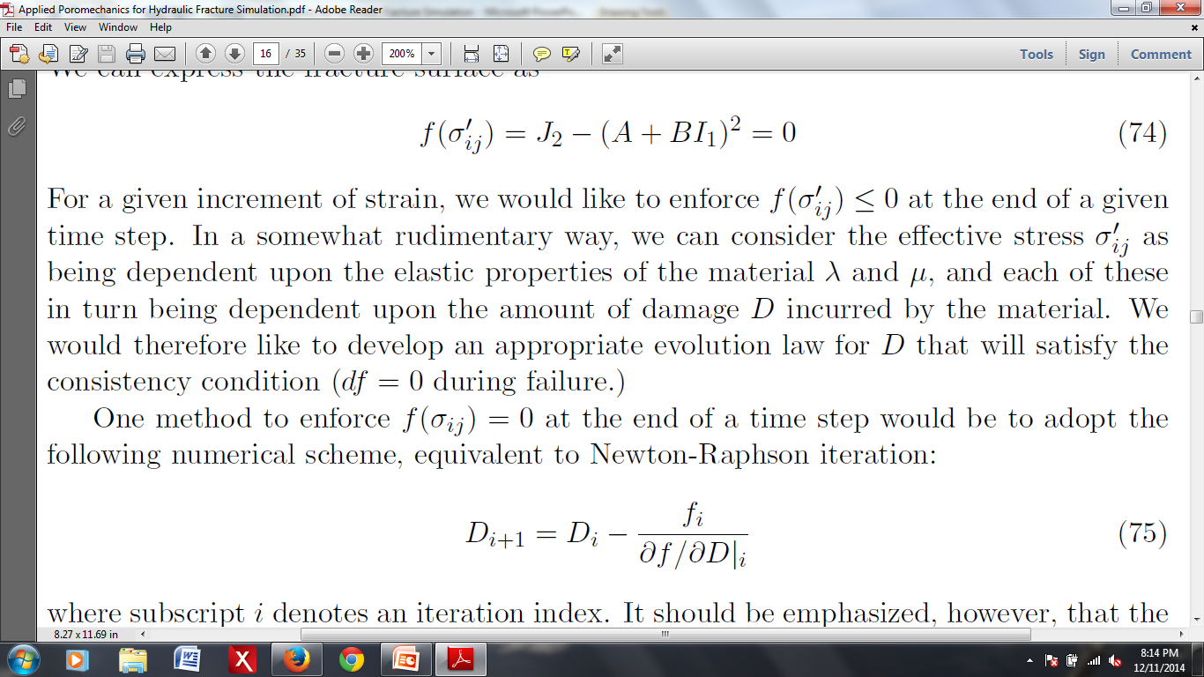

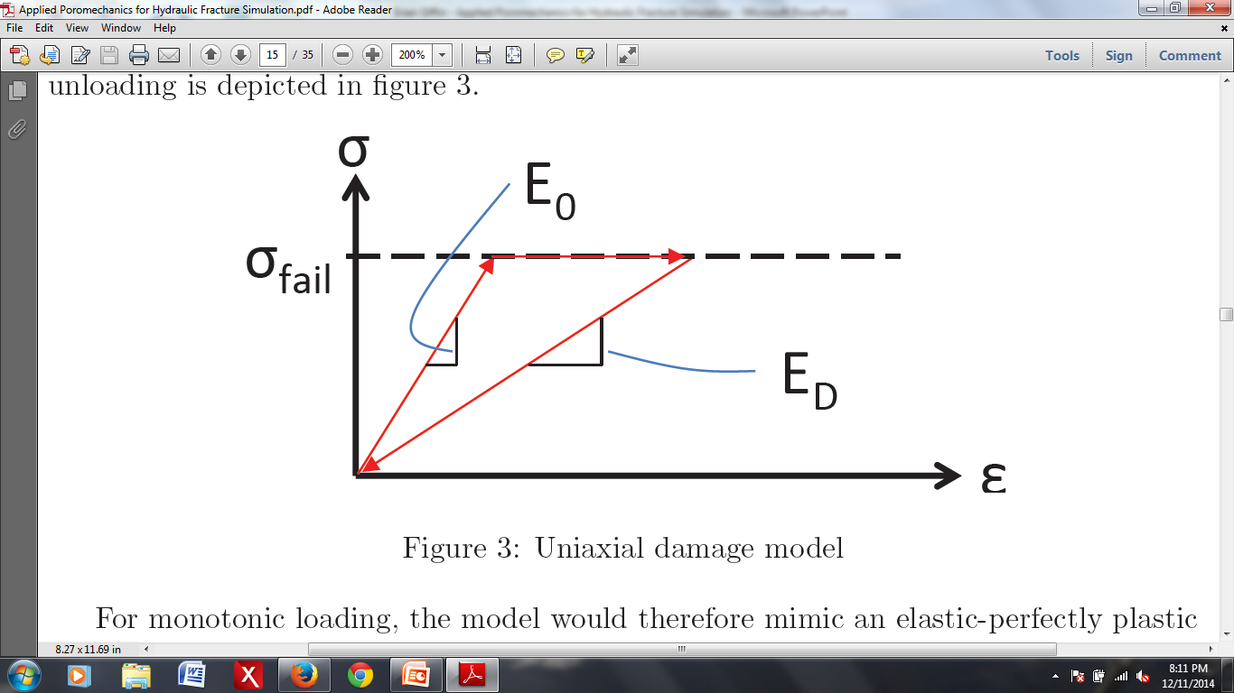
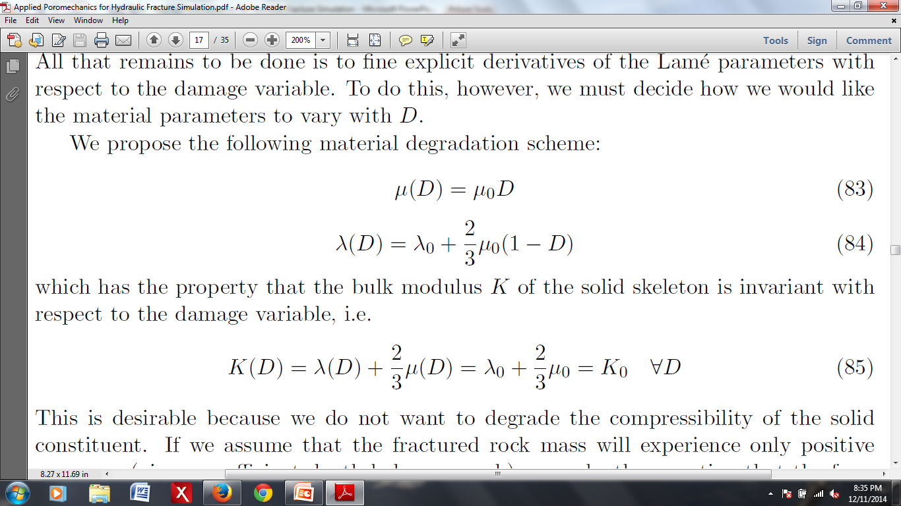
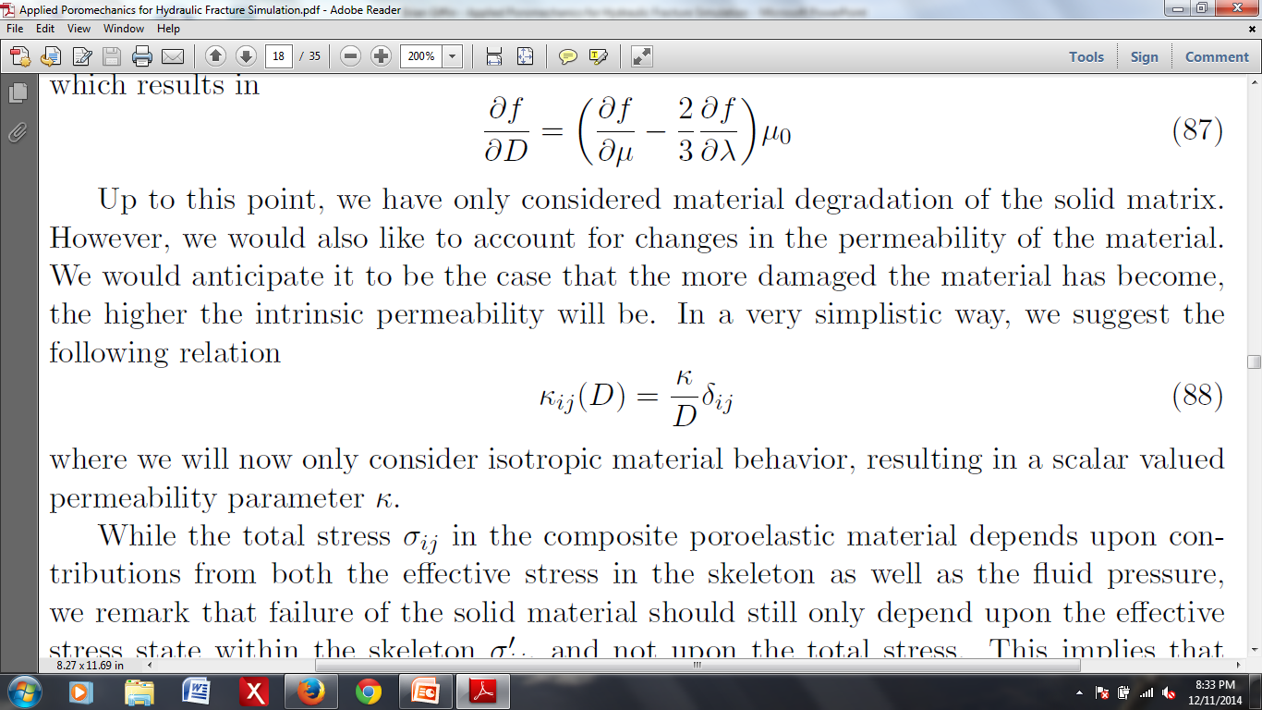
Damage Evolution Law
Permanent, irreversible degradation of the elastic properties and hydraulic conductivity:
Failure surface:
Consistency condition: during failure

Slide 17
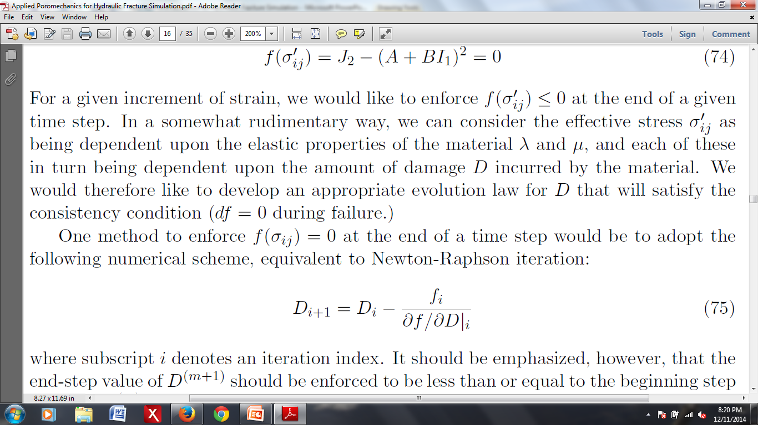
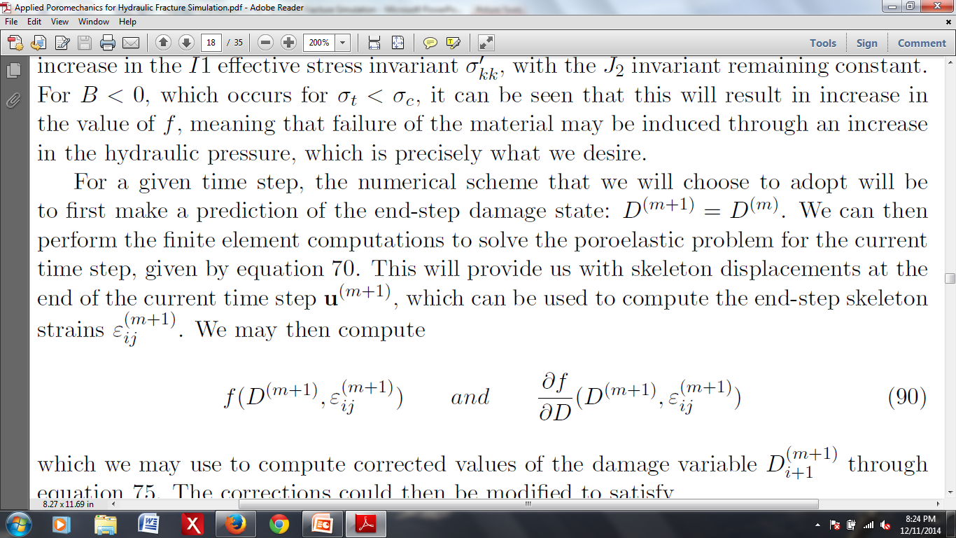
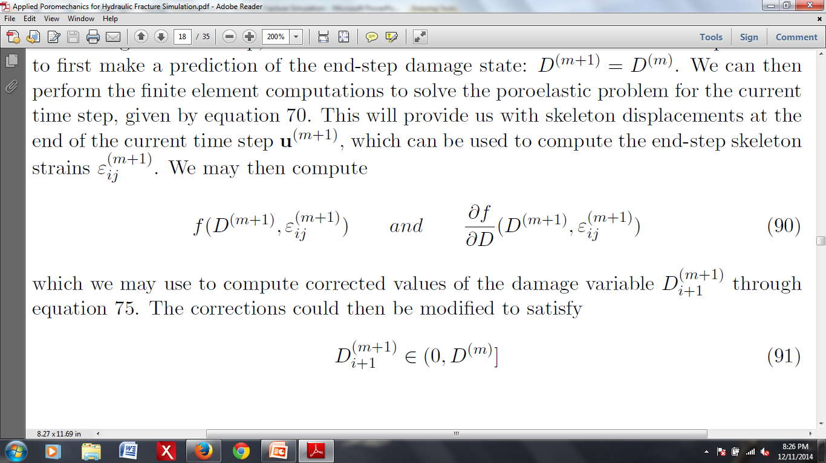
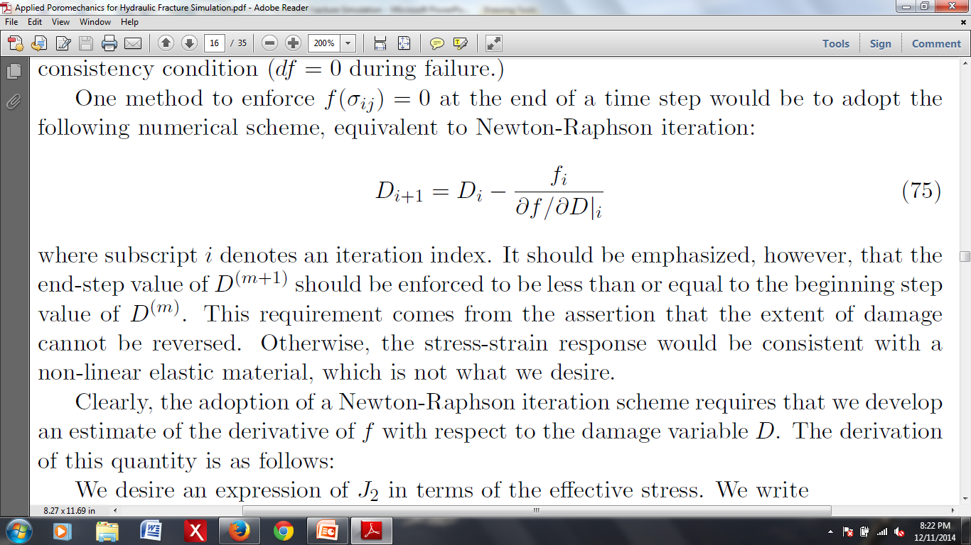
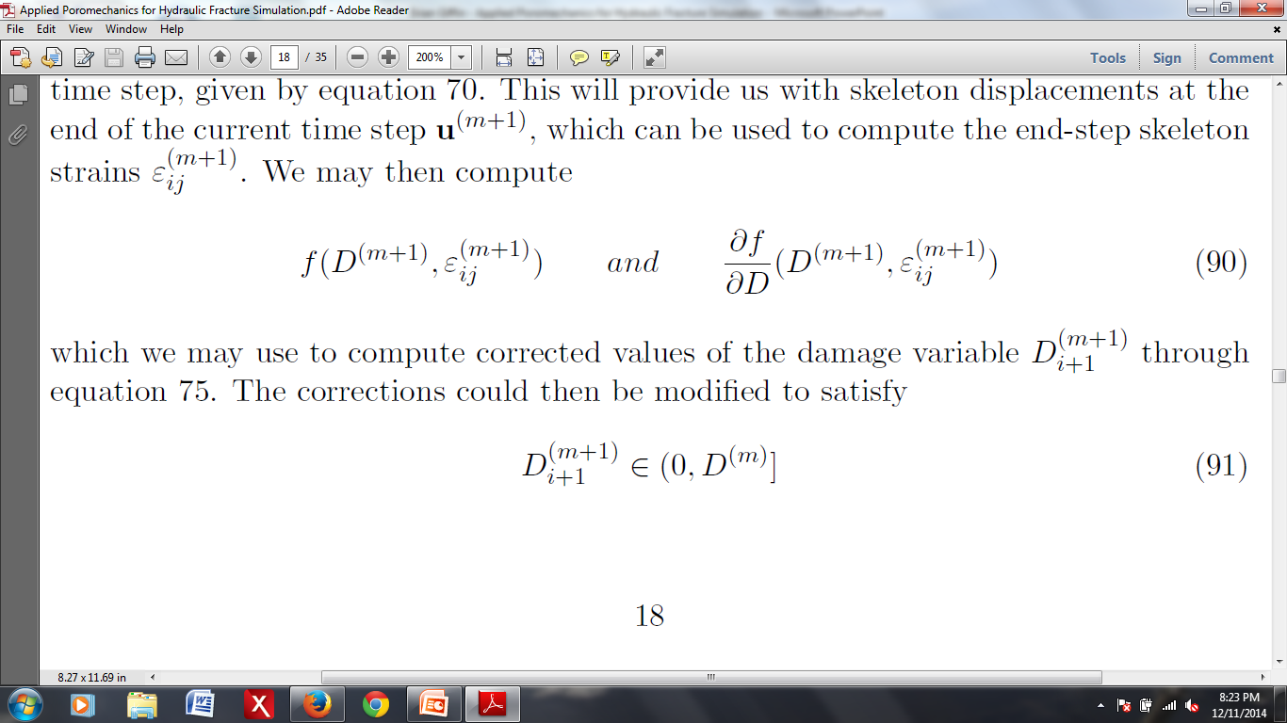
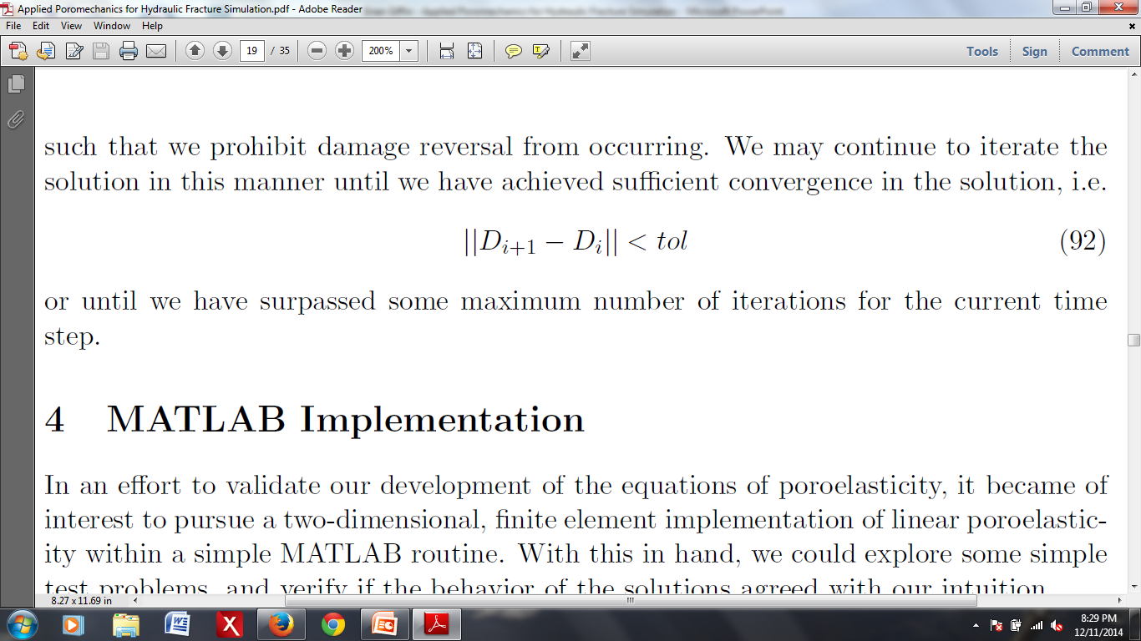
Numerical Scheme
Enforce at end of time-step:
Set initial guess:
Solve system of equations to obtain updated end-step displacements and pressures
Compute:
Update the damage variables by Newton-Raphson:
Enforce:
Iterate until:

Slide 18
MATLAB Implementation
Intended to validate the poroelasticity equations
2D linear poroelasticity
No damage mechanics
Time invariant material properties
Only Cartesian meshes (variable refinement)
Fully-integrated, isoparametric, four-node quadrilateral element formulation
Simple boundary condition types:
Homogeneous essential BCs
Zero flux BCs
Pressure traction BCs

Slide 19
Test Problem
2-D cube of poroelastic material subjected to an external pressure load
u_{(normal)} = 0 on
p = 0 on
V_{i}n_{i} = 0 on
σ_{(normal)j}n_{j} = - P(t) on
σ_{(transverse)j}n_{j} = 0 on

Slide 20
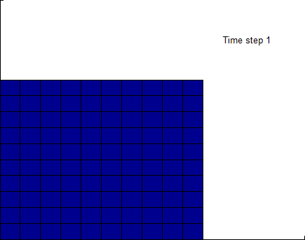
Test Problem 1
Material: homogeneous, isotropic, time invariant
P
t

Slide 21
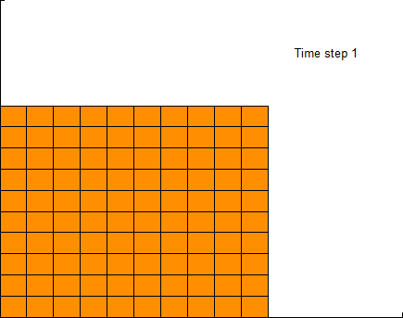
Test Problem 2
P(t) = constant
P
t

Slide 22
Pressure Oscillations
Known issue with coupled poromechanics
Occurs for:
Incompressibility constraint
Violation of minimum time step criterion
Can be overcome through mesh refinement
There exist several remediation techniques
Fluid pressure Laplacian stabilization (FPL)
Adds stabilization terms to the weak form

Slide 23
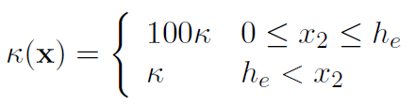
Test Problem 3
Inhomogeneous material properties

Slide 24
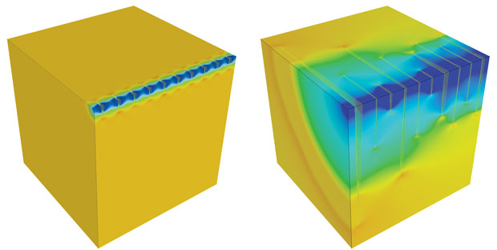
GEOS
Open source FE code written in C++
Developed by LLNL for use on HPC platforms
Emphasis on modeling hydraulic fracture

Slide 25
Physics Solvers
Code based around physics `solvers’
Different solvers model different physics
e.g. solid mechanics or fluid mechanics
Solvers implemented as C++ classes
`SolverBase’ class contains most of the rudimentary solver functionality
All other solvers derived from `SolverBase’
Goal: create a `PoromechanicsSolver’ class

Slide 26
Implementation
Key class methods:
TimeStep: A single time stepping procedure
Assemble: Assembles global equation system
CalculateElementResidualAndDerivative:
Computes element contributions to the global `stiffness’ matrix and residual vector
Apply<Type>BoundaryConditions: EBCs, NBCs
Solve: Solves the linear system of equations
UpdateDamage: Updates D for each element

Slide 27
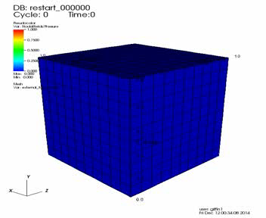
3D Test Problem
3D version of MATLAB Test Problem 1, using GEOS

Slide 28
Pressure-Driven Damage Test
2D block of initially undamaged poroelastic material
u_{(normal)} = 0 on
p = 0 on
V_{i}n_{i} = 0 on top, left, bottom faces of
V_{i}n_{i} = F on right face
(F < 0, inward directed)

Slide 29
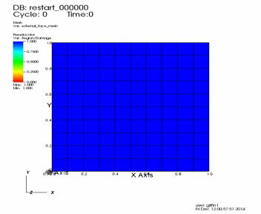
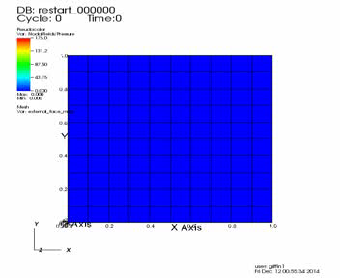
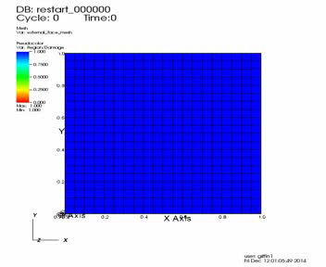

Damage
Pressure
10x10
20x20

Slide 30
Future Work
Differentiate between crack initiation and propagation
Would require proper identification of crack tips
Investigate anisotropic material degradation
Employ a more sophisticated damage evolution law
Look at plasticity models for granular materials
Pursue methods for abating spurious pressure oscillations (FPL)

Slide 31
Questions?

